Slide 1
Incident Response Management-Unit-1

Slide 2
Objectives
Students should be able to:
Define and describe an incident response plan and business continuity plan
Describe incident management team, incident response team, proactive detection, triage
Define and describe computer forensics: authenticity, continuity, forensic copy, chain of custody, root cause,
Define external test, internal test, blind test, double blind test, targeted test.
Develop a high-level incident response plan.
Describe steps to obtain computer forensic information during an investigation.
Describe general capabilities of a forensic tool.
Describe steps to copy a disk.
Define discovery, e-discovery, deposition, declaration, affidavit, fact witness, expert consultant, expert witness.

Slide 3
Event
An event is any observable occurrence in a system or network:
Events include a user connecting to a file share
A server receiving a request for a web page
A user sending an email
A firewall blocks a connection attempt.
Adverse events are events with a negative consequence:
Such as system crashes
Packet floods
Unauthorized use of system privileges
Unauthorized access to sensitive data
Execution of malware that destroys data.

Slide 4
A computer security incident is a violation or imminent threat of violation of computer security policies, acceptable use policies, or standard security practices. Examples of incidents2 are:
1. An attacker commands a botnet to send high volumes of connection requests to a web server, causing it to crash.
2. Users are tricked into opening a “quarterly report” sent via email that is malware; running the tool has infected their computers and established connections with an external host.
3. An attacker obtains sensitive data and threatens that the details will be released publicly if the organization does not pay a designated sum of money.
4. A user provides or exposes sensitive information to others through peer-to-peer file sharing services.

Slide 5
Business Impact
Criminal:
Stolen data: financial, Point of sale, medical
Regulation & liability
Espionage:
Stolen engineering or marketing plans, trade secrets
Stolen government data
Warfare:
Denial of service
Destruction

Slide 6
1. "Management should establish a computer security incident handling capability to address security incidents by providing a centralized platform with sufficient expertise and equipped with rapid and secure communication facilities.
Incident management responsibilities and procedures should be established to ensure an appropriate, effective and timely response to security incidents.“
The purpose of security incident response is to bring needed resources together in an organized manner to deal with an adverse event known as an "incident" that is related to the safety and or security of the information system.

Slide 7
The security incident response process is centered on the preparation, detection and analysis, containment, investigation, eradication, recovery, and post incident activity surrounding such an incident. The objectives of security incident response activities are to:
limit the immediate incident impact to customers and business partners Always keeping in mind the first objective of any security activity is to the secure the data
Recover from the incident. Recovery and returning to normal operations is critical for every business or agency
Determine how the incident occurred. Detailed evaluation and analysis to find out how an incident occurs is a best business practice
Find out how to avoid further exploitation of the same vulnerability. Prudent security practices show need for mitigation of identified risks.
Avoid escalation of further incident. Containment is one of the important steps to any incident-handling action.

Slide 8
F. Assess the impact and damage in terms of:
1. financial impact
2. loss of data
3. loss of processing
4. data breaches
5. reputation, etc.
Risk and impact assessments post-incident provide more focus and attention to actual issues for security and operations in any organization.
G. Update corporate security policies and procedures as necessary. Developing lessons learned for incidents gives organizations ways to improve security posture and procedures for both actual security and compliance-reporting efforts.

Slide 9
Incident Response vs.
Business Continuity
Incident Response Planning (IRP)
Security-related threats to systems, networks & data
Data confidentiality
Non-repudiable transactions
Business Continuity Planning
Disaster Recovery Plan
Continuity of Business Operations
IRP is part of BCP and can be *the first step*
NIST SP 800-61 defines an incident as “a violation or imminent threat of violation of computer security policies, acceptable use policies, or standard security practices.”
Notes:
Business continuity planning has broader scope than IRP; how will you continue to do business (and earn profits and pay your employees) after an incident that disrupts it? In addition to purely IT systems, ‘threats to systems..’ etc includes threats to infrastructure and personnel; physical storage, skill inventory and so on.
Incident Response – focuses on IT attacks and prevention
Business Continuity focuses on business, of which IT is an important part, but only a part of the story.

Slide 10
Review: Business Continuity Recovery Terms
Interruption Window: Time duration organization can wait between point of failure and service resumption
Service Delivery Objective (SDO): Level of service in Alternate Mode
Maximum Tolerable Outage: Max time in Alternate Mode
Disaster
Recovery
Plan Implemented
Regular Service
Regular
Service
SDO
Alternate Mode
Time…
Restoration
Plan Implemented
Interruption
(Acceptable)
Interruption
Window
Maximum Tolerable Outage
Notes:
The interruption window is the time between failure and restoration of a minimal level of critical services – the minimum needed to carry on. The MTO is the acceptable time between failure and return to full operations.
Recovery time objective (RTO) is the maximum time between an incident and alternate mode becoming available; that is, the length of the acceptable interruption window.

Slide 11
Vocabulary
IMT: Incident Management Team
Exe. Board member, includes steering committee, IRT members
Develop strategies & design plan for Incident Response,
integrating business, IT, BCP, and risk management
Obtain funding, Review postmortems
  Meet performance & reporting requirements
IRT: Incident Response Team
Handles the specific incident. Has specific knowledge relating to:
Security, network protocols, operating systems, physical
security issues, malicious code, etc.
Permanent (Full Time) Members: IT security specialists,
incident handlers, investigator
Virtual (Part Time) Members: Business (middle mgmt), legal,
public relations, human resources, physical security, risk, IT
Notes:
The slide shows higher ranking positions on top, lower ranking on the bottom.

Slide 12
Stages in Incident Response
Preparation
Plan PRIOR to Incident
Identification
Determine what is/has happened
Containment
& Escalation
Limit incident
[If data breach]
Analysis &
Eradication
Determine and remove
root cause
Notification
Notify any data
breach victims
Recovery
Return operations
to normal
Ex-Post
Response
Establish call center,
reparation activities
Lessons
Learned
Process improvement:
Plan for the future
Notes:
The next slides will go through these steps in detail.
Source: CISM® Review Manual 2009, © 2008, ISACA. All rights reserved. Used by permission.

Slide 13
Why is incident response important?
Average Cost of Data Breach:
Global $4.88M (2024); U.S. $7.91M for 31,465 records
Mega Breach: 1 M records: $40 million 50 M records: $350 million
Mean Time to Identify (MTTI): Days to find, confirm the breach
Mean Time to Contain (MTTC): Days to resolve breach and restore service
 | Global | U.S. | India | Criminal attack | System Glitch | Human Error
Mean Time to Identify | 196.7 | 201 | 188 | 221 | 177 | 174
Mean Time to Contain | 69.0 | 52 | 78 | 81 | 60 | 57
2018 Cost of a Data Breach Study: Global Report (IBM/Ponemon)

Slide 14
Stage 1: Preparation
What shall we do if different types of incidents occur? (BIA helps)
When is the incident management team called?
How can governmental agencies or law enforcement help?
When do we involve law enforcement?
What equipment do we need to handle an incident?
What shall we do to prevent or discourage incidents from occurring? (e.g. banners, policies)
Where on-site & off-site shall we keep the IRP?
Creation of incident handling checklists
Ensure the corporate disaster recovery plan is up to date.
Making sure the security risk assessment process is functioning and active.
Notes:
A business impact assessment (BIA) should be conducted by each business process (department, whatever) to determine how an incident will affect it and what steps should be taken to mitigate or respond to it. This is part of risk management as well as incident response.
The incident response plan (IRP) is the document that contains procedures to follow in case of an emergency (see slide 11). It should be usable by someone who wasn’t involved in its creation, and needs to be accessible in unusual circumstances – if the only copy is in your desk drawer when a fire guts your office building, then you’re doing it wrong.
Bullet 3, 4: meet with government emergency management (law enforcement, etc) to learn what they are capable of and how they prefer to operate.

Slide 15
Preparation (Cont.)
An important to preparation is having predeployed incident handling assets. These assets include:
Sensors, probes, and monitors on critical systems. These automated mechanisms allow monitoring of:
1. System applications with a service and network monitoring program
2. CPU utilization, disk space, processes, and other pertinent metrics and investigating any unusual.
3. Access to the application (allows and denies).
B. Tracking databases on core systems based upon minimum security baselines (snapshots of the systems or networks during normal operations) and the corporate Configuration Management Data Base (CMDB)
C. Active audit logs for all server and network components-where the logs are retained, how often the logs are updated, who controls them, etc.

Slide 16
Detection/ Identification:
Suspicious Entries in System or Network Accounting The accounting logs for each location should provide indicators of unusual actions in the system or network activities.
Excessive Unsuccessful Login Attempts (>3 per user)Usual security controls are designed to deny access once three unsuccessful logins are attempted in a row. This is an indicator of potentially malicious attackers trying to access systems or networks without having compromised credentials
Unexplained New User Accounts: Compromised administrative accounts often will indicate the creation of new accounts for the purposes of creating malicious user access to systems and networks.
Unexplained New Files: New files are often added to the system directories expecting users not to be aware of the normal file set within these directories

Slide 17
5. Unfamiliar File Names: The modern malware event today often loads files onto a system hard drive with files which are not normally found in a modem operating system. These files can be identified and evaluated quickly once discovered.
6. Modifications to file names and/or dates, especially in system executable files "Hackers" often rename malicious executable files with names of normal files and then place them into the expected directories of the operating system.
7. Intrusion Detection System (IDS) Alerts or Alarms Network- and host-based Intrusion Detection Systems can often provide the responder indications of potential malicious or harmful activity so they should be reviewed and examined during initial response efforts to gain a possible path of attack and/or access of the malicious incident.

Slide 18
8. External notifications (either outside users, customers, or emergency personnel) Often the first indication of a problem comes from external sources, such as the local Computer Emergency Response Team (CERT) or outside users indicating they have received a strange or unusual indicator.
9. E-mail flood from unsuspecting helper E-mail flooding, often an indicator of a worm event, can provide a responder with indications of access methods and techniques used to gain a method of ingress into the network and should be used to instigate a response.

Slide 19
(1) Detection/Identification Technologies
Organization must have sufficient detection & monitoring capabilities to detect incidents in a timely manner
Proactive Detection includes:
Network Intrusion Detection/Prevention System (NIDS/NIPS)
Host Intrusion Detection/Prevention System (HIDS/HIPS)
Antivirus, Endpoint Security Suite
Security Information and Event Management (Logs)
Vulnerability/audit testing
System Baselines, Sniffer
Centralized Incident Management System
  Input: Server, system logs
  Coordinates & co-relates logs from many systems
  Tracks status of incidents to closure
Reactive Detection: Reports of unusual or suspicious activity
Notes:
You can’t determine if an incident has occurred unless there are detection techniques. It makes sense that there is a detection technique and/or metric for each risk of concern. The above tools do not need to be implemented, depending on the decision of risk assessment. However, they are useful tools for detecting incidents.

Slide 20
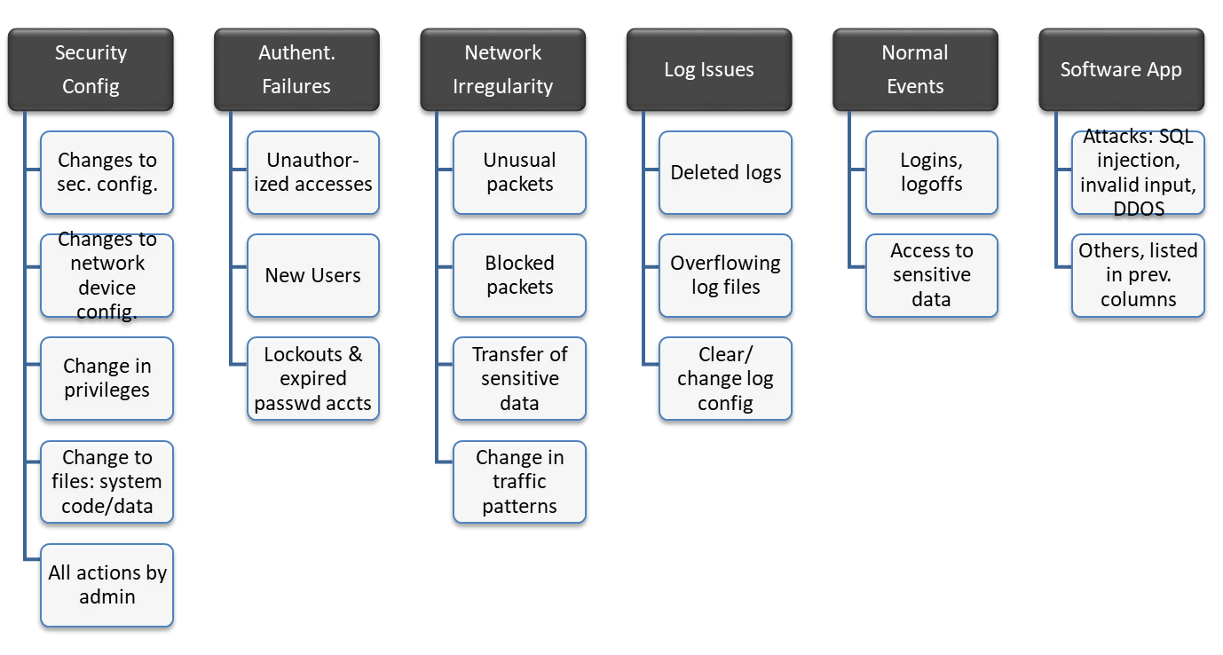
Logs to Collect & Monitor

Slide 21
Incidents may include…
Employees Reports
IT Detects
Malware
Violations of policy
Data breach:
  stolen laptop, memory
  employee mistake
Social engineering/fraud:
  caller, e-mail, visitors
Unusual event:
  inappropriate login
  unusual system aborts
  server slow
  deleted files
  defaced website
a device (firewall, router or server) issues serious alarm(s)
change in configuration
an IDS/IPS recognizes an irregular pattern:
  unusually high traffic,
  inappropriate file transfer
  changes in protocol use
unexplained system crashes or
unexplained connection terminations

Slide 22
(1) Management Participation
Management makes final decision
  As always, senior management has to be convinced that this is worth the money.
Actual Costs: Cost of a Data Breach Study, 2018, Ponemon, IBM
Expenses Following a Breach | Average Cost (U.S.)
Detection and Escalation: forensic investigation, audit, crisis mgmt., board of directors involvement | $1,210,000
Notification: legal expertise, contact database development, customer communications | $740,000
Post Breach Response: help desk and incoming communications, identity protection services, legal and regulatory expenses, special investigations | $1,760,000
Lost Business: abnormal customer churn, customer procurement, goodwill | $4,200,000
Notes:
Redundancy costs are costs of alternate equipment/lines to deal with incidents. The cost of the redundancy and detection can be weighed against the Business Impact Analysis costs when incidents occur – and the impact of how loss of computing facilities might translate into lost income.

Slide 23
Workbook
Incident Types
Incident | Description | Methods of Detection | Procedural Response
Intruder accesses internal network | Firewall, database, IDS, or server log indicates a probable intrusion. | Daily log evaluations, high priority email alerts | IT/Security addresses incident within 1 hour: Follow: Network Incident Procedure Section.
Break-in or theft | Computers, laptops or memory is stolen or lost. | Security alarm set for off-hours; or employee reports missing device. | Email/call Management & IT immediately. Management calls police, if theft. Security initiates tracing of laptops via location software, writes Incident Report, evaluates if breach occurred.
Social Engineering | Suspicious social engineering attempt was recognized OR information was divulged that was recognized after the fact as being inappropriate. | Training of staff leads to report from staff | Report to Management & Security. Warn employees of attempt as added training. Security evaluates if breach occurred, writes incident report.
Trojan Wireless LAN | A new WLAN masquerades as us. | Key confidential areas are inspected daily for WLAN availability | Security or network administrator is notified immediately. Incident is acted upon within 2 hours.
Notes:
This is in an abbreviated form to fit on a slide. The Method of Detection is how we will know if an incident occurs. There may be many methods. The procedural response can refer to another document, which has a more extensive description. (Short form shown here)

Slide 24
Stage 2: Identification
Triage: Categorize, prioritize and assign events and incidents
What type of incident just occurred?
What is the severity of the incident?
    Severity may increase if recovery is delayed
Who should be called?
Establish chain of custody for evidence
Notes:
You may remember from MASH (TV show and movie) that Triage is about stopping bleeding and prioritizing injuries to maximize the probability of survival. Same thing here: determining what is wrong and taking the correct first actions until the bleeding stops and the experts are ready to take over.
How to declare a disaster involves more than communication; it also means when to declare a disaster, as opposed to some lesser incident. You want your response to be proportional to the scale of the incident . If you overreact (shutting down the entire network over one unauthorized entry) you’ll waste a lot of time and money. If you underreact, the incident may become a lot worse than it already is.

Slide 25
(2) Triage
Snapshot of the known status of all reported incident activity
  Sort, Categorize, Correlate, Prioritize & Assign
Categorize: DoS, Malicious code, Unauthorized access, Inappropriate usage, Multiple components
Prioritize: Limited resources requires prioritizing response to minimize impact
Assign: Who is free/on duty, competent in this area?
Notes:
Triage happens at a hospital: When you come in you are asked questions to determine how long you can wait to see a doctor. (You get prioritized compared to the other emergency patients.) They may bandage you to stop any bleeding, but think military war zone: a full operation is not done.

Slide 26
(2) Chain of Custody
Evidence must follow Chain of Custody law to be admissible/acceptable in court
  Include: specially trained staff, 3rd party specialist, law enforcement, security response team
System administrator can:
Retrieve info to confirm an incident
Identify scope and size of affected environment (system/network)
Determine degree of loss/alteration/damage
Identify possible path of attack
Notes:
Chain of Custody will be necessary if anything will go to court. Need to be concerned with this right from the start, if a concern.
Chain of Custody requires that a witness be present for all actions taken, that a qualified ‘expert’ does the incident response and forensic work (or the work accomplished stands up in court as professional), that the original disk is not modified, and that the whereabouts of the disk is always secure from the point of the incident on – locked, limited key access, witnessed, etc.

Slide 27
Stage 3: Containment
Activate Incident Response Team to contain threat
  IT/security, public relations, mgmt, business
Isolate the problem
  Disable server or network zone comm.
  Disable user access
  Change firewall configurations to halt connection
Obtain & preserve evidence
Notes:
Employees who are not directly involved in incident response still need to know their roles, even if its just to get out of the way and let the IRT work.
The proper actions are defined in the Incident Response plan, which should always be followed. For example, no one should be talking to the news accept public relations or top management.

Slide 28
(3) Containment - Response
Technical
Collect data
Analyze log files
Obtain further technical assistance
Deploy patches & workarounds
Managerial
Business impacts result in mgmt intervention, notification, escalation, approval
Legal
Issues related to: investigation, prosecution, liability, privacy, laws & regulation, nondisclosure
Notes:
Issues may affect IT, management, and even legal, depending on the incident.

Slide 29
Stage 4: Analysis & Eradication
Determine how the attack occurred: who, when, how, and why?
  What is impact & threat? What damage occurred?
Remove root cause: initial vulnerability(s)
  Rebuild System
  Talk to ISP to get more information
  Perform vulnerability analysis
  Improve defenses with enhanced protection techniques
Discuss recovery with management, who must make decisions on handling affecting other areas of business
Notes:
Forensics can be a useful tool here.
Rebuilding may be necessary is someone attacked your computer – and entered as admin in particular. While some of the malware may be detected, it is possible that backdoors and rootkit parts may not be detected – including replaced OS software or new login/passwords added. So you may know part of what the attacker did, but not all. It would be best to rebuild the entire system, when in doubt, if security is a concern.

Slide 30
(4) Analysis
What happened?
Who was involved?
What was the reason for the attack?
Where did attack originate from?
When did the initial attack occur?
How did it happen?
What vulnerability enabled the attack?
Notes:
Here it is time to determine the root of the problem and its effects.

Slide 31
(4) Remove root cause
If Admin or Root compromised, rebuild system
Implement recent patches & recent antivirus
Fortify defenses with enhanced security controls
Change all passwords
Retest with vulnerability analysis tools

Slide 32
Stage 5: Recovery
Restore operations to normal
Ensure that restore is fully tested and operational

Slide 33
Workbook
Incident Handling Response
Incident Type: Malware detected by Antivirus software
Contact Name & Information: Computer Technology Services Desk: www.univ.edu/CTS/help 262-252-3344(O)
Emergency Triage Procedure: Disconnect computer from Internet/WLAN. Do not reconnect. Allow anti-virus to fix problem, if possible. Report to IT first thing during next business day.
Containment & Escalation Conditions and Steps: If laptop contained confidential information, investigate malware to determine if intruder obtained entry. Determine if Breach Law applies.
Analysis & Eradication Procedure: If confidential information was on the computer (even though encrypted), malware may have sent sensitive data across the internet; A forensic investigation is required. Next, determine if virus=dangerous and user=admin: Type A: return computer. (A=Virus not dangerous and user not admin.) Type B: Rebuild computer. (B=Either virus was dangerous and/or user was admin) Password is changed for all users on the computer.
Other Notes (Prevention techniques): Note: Antivirus should record type of malware to log system.
Notes:
This is an abbreviated form to fit on one page. Some incidents will be heavy in certain areas compared to others. In this case, emergency triage is not a big concern – only that the matter not become worse by continuing to allow the computer to be Internet-accessible.

Slide 34
Stage 6: Lessons Learned
Follow-up includes:
Writing an Incident Report
  What went right or wrong in the incident response?
  How can process improvement occur?
  How much did the incident cost (in loss & handling & time)
Present report to relevant stakeholders
Notes:
This slide refers mainly to the incident process itself and how to make it better for the next time. However it is also a good time to review preventative measures. Were they adequate (given that they failed) and was the cost of the incident high enough to justify spending more resources in order to avoid another?

Slide 35
Types of Penetration Tests
External Testing: Tests from outside network perimeter
Internal Testing: Tests from within network
Blind Testing: Penetration tester knows nothing in advance and must do web research on company
Double Blind Testing: System and security administrators also are not aware of test
Targeted Testing: Have internal information about a target. May have access to an account.
Written permission must always be obtained first

Slide 36

Incident Management Metrics
# of Reported Incidents
# of Detected Incidents
Average time to respond to incident
Average time to resolve an incident
Total number of incidents successfully resolved
Proactive & Preventative measures taken
Total damage from reported or detected incidents
Total damage if incidents had not been contained in a timely manner
Notes:
Keep in mind, just because you don’t detect any incidents doesn’t mean there aren’t any.

Slide 37
Challenges
Management buy-in: Management does not allocate time/staff to develop IRP
  Top reason for failure
Organization goals/structure mismatch: e.g., National scope for international organization
IMT Member Turnover
Communication problems: Too much or too little
Plan is to complex and wide

Slide 38
Sign of an incident
The most challenging part of the incident response process is accurately detecting and assessing possible incidents – determining whether an incident has occurred.
And, if so, the type, extent, and magnitude of the problem. What makes this so challenging is a combination of three factors:
Incidents may be detected by automated detection capabilities include network-based and host-based IDPSs, antivirus software, and log analyzers.
Incidents may also be detected through manual means, such as problems reported by users.
Some incidents have overt signs that can be easily detected, whereas others are almost impossible to detect.

Slide 39
Deep, specialized technical knowledge and extensive experience are necessary for proper and efficient analysis of incident-related data.
Signs of an incident fall into one of two categories: precursors and indicators.
A precursor is a sign that an incident may occur in the future.
An indicator is a sign that an incident may have occurred or may be occurring now.
If precursors are detected, the organization may have an opportunity to prevent the incident by altering its security posture to save a target from attack. At a minimum, the organization could monitor activity involving the target more closely. Examples of precursors are:
  Web server log entries that show the usage of a vulnerability scanner
  An announcement of a new exploit that targets a vulnerability of the organization's mail server
  A threat from a group stating that the group will attack the organization.

Slide 40
While precursors are relatively rare, indicators are all too common. Too many types of indicators exist to exhaustively list them, but some examples are listed below:
A network intrusion detection sensor alerts when a buffer overflow attempt occurs against a database server.
Antivirus software alerts when it detects that a host is infected with malware
A system administrator sees a filename with unusual characters
A host records an auditing configuration change in its log.
An application logs multiple failed login attempts from an unfamiliar remote system.
An email administrator sees a large number of bounced emails with suspicious content.
A network administrator notices an unusual deviation from typical network traffic flows.

Slide 41
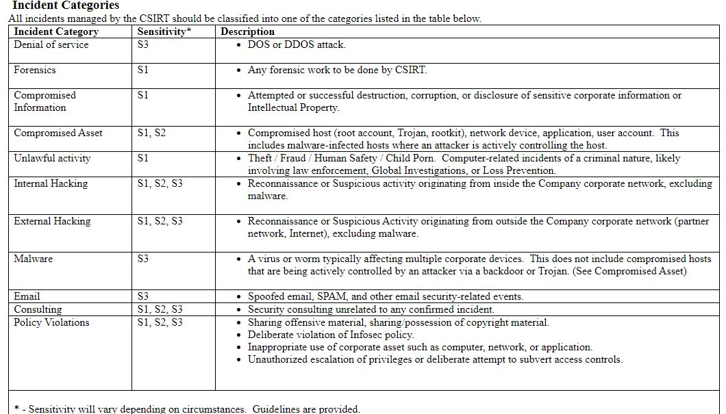

Slide 42
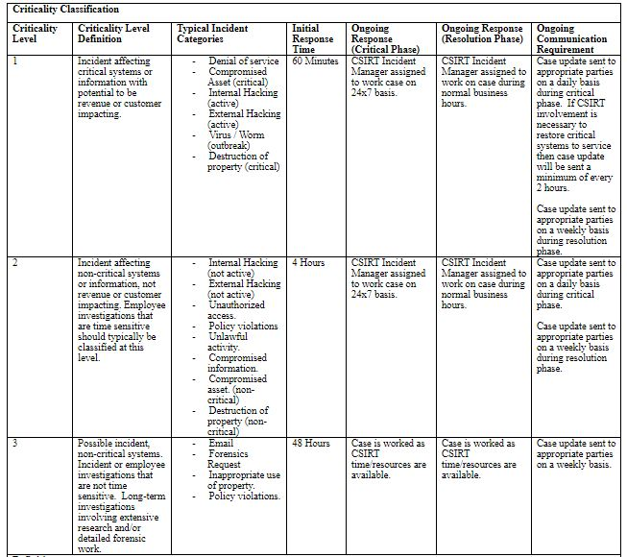

Slide 43
